Slide 1

Bystander Intervention
Training
Kennedy Aliu
VP Liberation
He/him
Rosalie Chapman
VP Welfare
She/her
Daisy O'Connor
Student Engagement Democracy & Communities Manager
She/her

Slide 2

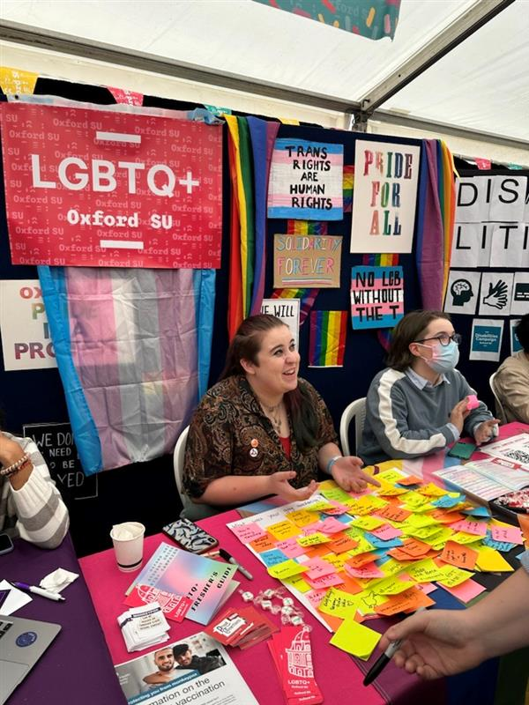

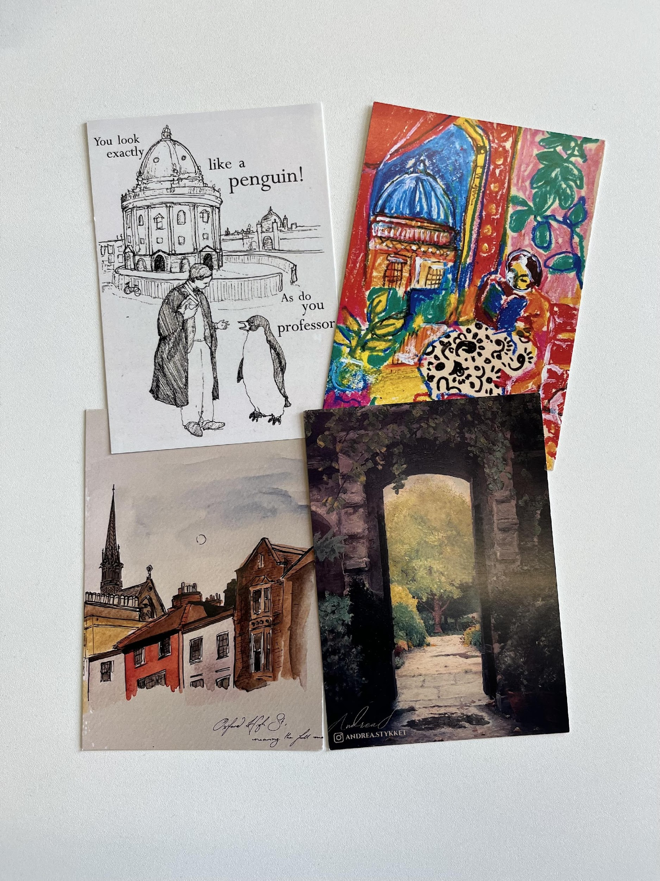
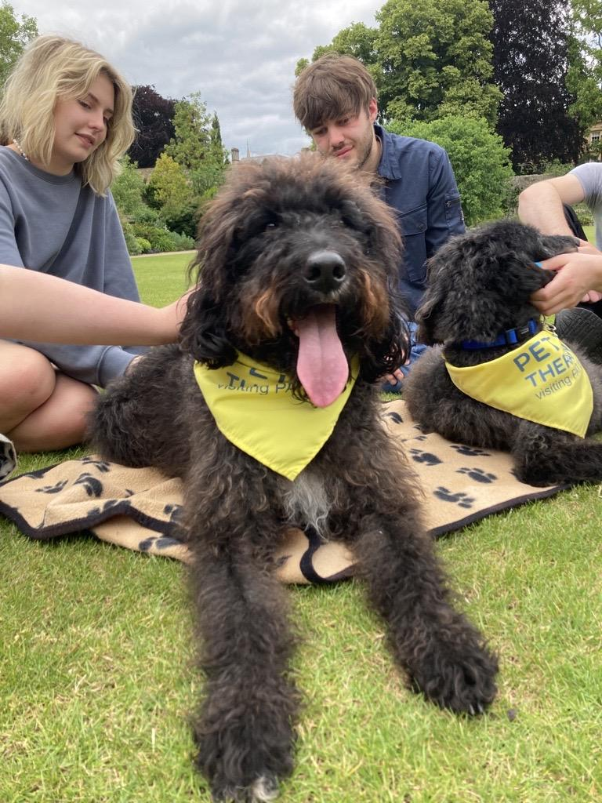






Oxford SU is here to represent, support, and create communities for all 25,000+ University of Oxford students.
Notes:
Lizzy

Slide 3
Introduction and Expectations
This session will:
Develop your understanding of what it means to be an effective ally and assist those targeted by harassment
Equip you with the skills to proactively engage with and challenge difficult behaviours as you see them happening
This session is not:
Training to counsel people or give long-term support
Training to equip you to respond to first disclosures
Notes:
This training is an opportunity for you to equip yourself with some skills which you can use to proactively engage with and challenge difficult behaviours as you see them.
Bystander intervention is a significant strategy in the prevention of sexual violence and other types of harassment, but it has its limitations.
This training will not: equip you with the skills to counsel people or give long-term support, nor will it prepare you to respond to first disclosures. – you aren’t trained to do that so you need to sign post on
There are people within the collegiate university who are trained to support someone in this way, and later in this training we will explore what services you can signpost students to, and how you can lobby to make these services even better.
Lizzy

Slide 4
Ground Rules
Mutual Respect
Feeling free to leave if uncomfortable with the nature of the content
No judgement for anyone’s questions/comments or those who decide to leave
Ensuring we adopt a compassionate attitude towards victims of harassment
oxfordsu.org
Notes:
Encourage attendees to think of their own ground rules for the group. Make sure the following are agreed on by the group before continuing:
Respect one another
Confidentiality of the space
Normalize leaving/taking breaks
Personal stories: if the students themselves have not decided on a ground rule with regards to personal stories, encourage them to consider how they want to approach this before continuing with the training. Take into account your own wellbeing and whether you feel capable of leading the session if it will include personal stories. If personal stories are to be allowed, please ensure the following caveat is given – that wherever possible, all names and references which may identify the person being spoken of are omitted from the account e.g. identifying features like college etc.

Slide 5

Trigger Warnings/Content Notice
In this session, there will be mentions of (not graphic descriptions of):
Misogyny
Racism
Islamophobia
Sexual Harassment and Violence
Anti-Semitism
Transphobia
Homophobia
Stalking
Ableism
Non-sexual Harassment and violence

Slide 6
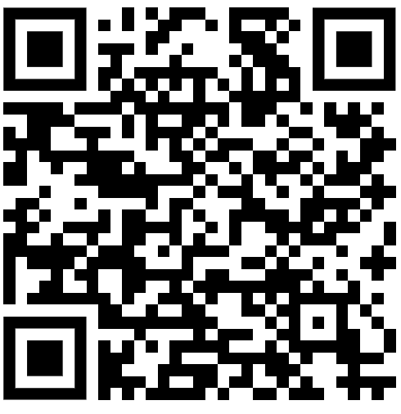
More Information

Slide 7
What Is Harassment?
The University’s Harassment Policy defines harassment as unwanted or unwarranted conduct which:
violates another person’s dignity, or
Creates an intimidating, hostile, degrading, humiliating or offensive environment for another person
Notes:
Anyone can be the target of harassment, but harassment is more likely to be experienced by those from marginalised groups, such as the LGBTQ or BME communities.
You can find the Harassment policy by searching Oxford University Harassment Policy
Each college is recommended to take up the university policy but they don’t have to, find out if your college has taken up the most recent updates, if not, lobby for your common room for them to!

Slide 8
What Is Harassment?
Examples of harassment include:
Sexually explicit, racist, ableist, transphobic, and other derogatory comments
Unwelcome comments about your appearance, accent, sexuality, etc.
Leering, making vulgar gestures, flashing you, or exposing oneself
Threatening to remove an item of clothing, which includes clothing of religious significance
Claiming that you don’t have the right to be in a public space
Whistling or kissing noises
Following you or blocking your path
Sexual touching, grabbing or other forms of inappropriate behaviour
Notes:
These are just limited examples and are not the be all and end all

Slide 9
What Is Harassment?
Remember
Drugs and / or alcohol never justify harassment
The survivor does not have to have called out the harassment in the moment for an incident to 'count' as harassment
Yes to free speech and debate, no to harassment and hate speech.
Notes:
Many people think that drugs/alcohol give people a free pass but that is not the case.
Also harassment doesn’t have to have been rejected IE if someone is making sexually explicit comments the receiver does not have had to say they don’t want them to happen, this is good because many people targeted by harassment don’t feel comfortable confronting their harasser.- this is where you can come in as an effective bystander
This is really important to emphasise as people seem to think free speech = hate speech
Hate speech -

Slide 10
Discussion: What Is Harassment?
Prompts:
Is there anything on the list of examples which surprised you?
Where are the grey areas when it comes to harassment?

Slide 11
Allyship
Notes:
Ask the group these questions and get them to feedback-
Why are certain groups targets for harassment?
How does this make targets feel?
Explain:As we understand already, harassment can be sexist, racist, religion-based, xenophobic, transphobic, homophobic, ableist, classist. Regardless of what grounds the harassment is taking place under, ultimately, harassment is an expression of the interlocking and overlapping oppressions marginalized groups face, which play out online and in public and seek to remind us of our marginalized status.

Slide 12
Discussion: What Is Allyship?
Prompts:
Where have you heard about Allyship before?
What do you think is good allyship?

Slide 13
What is Allyship?
Solidarity
Autonomy
Reflective
Notes:
Source- http://www.peernetbc.com/what-is-allyship
Solidarity
Active and consistent seeking to unlearn and re-evaluate your own privilege
Building relationships based on trust and accountability to marginalised groups/people
Life long process
Autonomy
Recognise that liberation groups want to and have autonomous / self governed spaces E.g. LGBTQ Clubs
This is because social hierarchies in everyday society often prohibit everyone from having the same amount of freedom to speak out E.g. in other clubs LGBTQ+ people are more likely to experience harassment and or discrimination so by having their own spaces they are able to be fully themselves with less fear of violence be that verbal/emotional/physical
These spaces are not open to you as an ally unless specifically invited E.g. going to a LGBTQ+ club just because it is cheap and plays good music without considering whether as a big group of straight cisgendered people you are compromising the assumed safety is a problem- similarly when straight hen parties go to lgbtq clubs because they’re fun ‘a laugh’. These spaces are not zoos.
These spaces do not further segregation or enforce exclusion. It is important for marginalized groups to have spaces they can truly be themselves without fear, until we are in a place in society where everyone is treated with complete equality and respect then there is going to be a need for liberation groups to have identity specific spaces.
Reflective
Be able to recognise when your involvement or presence is not appropriate or negatively impacts the groups you are trying to support- just because you are an ally to a group does not mean to have gained access to their spaces, sometimes your presence is not appropriate, for example, if a trans support group want to talk about problems they have had with cisgendered people they may not feel comfortable doing that if a cisgendered person is there, this defeats the point of the space.
You need to constantly be evaluating your behaviour and methods so that they are up to date- the landscape is constantly changing- Have you heard about this amazing thing called Google?
Listen to what marginalised groups/people are saying- we spend 80% of our time listening, we are never taught though how to listen even though we are taugh reading, writing and speaking. Think about the famous statement ‘nothing about us without us’.
You are not the centre of attention all the time- make space for marginalised people to speak and be platformed
Sometimes it might be appropriate to take a stronger position, for example if marginalised people are in a vulnerable position you can position yourself between them and the aggressor to protect them- important at protests especially if institutionally discriminatory institutions are there IE the police who are institutionally racist. (however you must only do this if you feel it safe to do so- safety is discussed later)

Slide 14
What is not Allyship?
An Identity
Self-defined
Not about being perfect
Notes:
An Identity
Being an ally is not something you identify as like how some people identify as queer, it is not a part of your identity which affects all aspects of your life.
Self-defined
Contributions made are not to be shouted about for congratulation
Self defining as an ally in no way helps you be one- allyship isn’t about you
Not about being perfect- important for Oxford as people are quite likely to want to be perfect
Allyship is about understanding you’re going through a long process of unlearning and learning
The ability to acknowledge mistakes is important
Accept being called out and move on
You are never the perfect ally- you can always learn more (Google is a good place to start before you start asking your only (insert minority) friend.

Slide 15
Good Ally Checklist
Listen more, speak less
If you are criticised for oppressive or exclusionary behaviour, accept
accountability and take responsibility.
Apologise and learn from your mistakes.
Recognise your privilege in the world, especially in relation to others.
Recognise that structural oppression is all-pervasive, even if you strongly believe that you do not perpetuate exclusionary or abusive behaviour.
Question and challenge the prevailing structures and keep challenging your own perspective.
Do not assume that experiences of marginalised groups are monolithic.
Do not speak for others without their consent. Help to provide platforms and spaces to empower and enable marginalised groups to represent their own experiences.
Do not expect reward or special recognition for confronting issues which marginalised people must face every day

Slide 16
The Bystander Effect
The bystander effect, or bystander apathy, is a social psychological theory that states that individuals are less likely to offer help to a victim when there are other people present.
Notes:
The Bystander Effect shows us that intervening in a threatening situation is not something we automatically do – we must make a conscious effort to engage with the issue and make steps to prepare ourselves to be able to do so in a way that is safe for you and has a positive outcome for the person being harassed.
It is especially important for students who hold positions of responsibility such as yourselves to feel confident intervening in these types of situations, as you are the student’s other students are most likely to turn to for help in these moments.

Slide 17
The Bystander Effect shows us that intervention is not something we automatically do - we must make a conscious effort to engage and make steps to prepare ourselves to be able to.
Notes:
The Bystander Effect shows us that intervening in a threatening situation is not something we automatically do – we must make a conscious effort to engage with the issue and make steps to prepare ourselves to be able to do so in a way that is safe for you and has a positive outcome for the person being harassed.
It is especially important for students who hold positions of responsibility such as yourselves to feel confident intervening in these types of situations, as you are the student’s other students are most likely to turn to for help in these moments.

Slide 18
Tackling Harassment:
The 5 D’s
DIRECT
DELEGATE
DELAY
DISTRACT
DOCUMENT
Notes:
5 D’s strategy was developed by Hollaback! in partnership with Green Dot, using the Green Dot Violence Prevention strategy as a model. You can find the links to Hollaback! at the end of the PowerPoint.
There are many strategies for intervention but we are going to learn the 5 D’s model, as this advice can be applied to most circumstances. Remember, the best way to respond to an incident is all situationally dependent, so before you do anything, always ask yourself: Is it safe for me to jump in? If so, how should I engage?
Your safety is the first priority. If you feel safe and choose to respond directly to harassers, you can use one of the 5 D’s to intervene:

Slide 19
DIRECT
naming what is happening and denouncing the harassers actions
DELAY
Following up and supporting target after incident
DOCUMENT
The act of recording or noting down the details (i.e. perpetrator, place, time) of an incident of harassment
DELEGATE
Getting assistance to intervene
DISTRACT
Interrupting the behavior of the harasser
Notes:
DIRECT
This D expects you to respond directly to harassment by naming what is happening and confronting why the harasser’s actions are wrong.
Be firm. Look them in the eye and denounce their behaviour with a strong, clear voice. Many people prefer to name the behaviour. For example, you can say “Do not [what they’re doing], that’s harassment.” You can also simply say “that is not okay” or “don’t speak to me like that.” Say what feels natural to you. The important thing is that you aren’t apologetic in your response.
Don’t engage. Harassers may try to argue with you or dismiss you through further conversation or by making fun of you. As tempting as it may be get into a verbal war with them, we don’t recommend it. The attention may further feed their abusive behaviour.
Keep moving. Once you’ve said your piece, keep it moving. Harassers don’t deserve the pleasure of your company.
DELEGATE
This is when you seek outside assistance to intervene in the situation. For example, a bystander can seek help or assistance from the police, a public transport worker or another outside party on behalf of the target.
Look for people to back you up when it’s time to intervene - Delegating is great because it can create a shared sense of responsibility among community members.
DELAY
If the other Ds don't work for you or your situation or if you feel like you missed an opportunity to intervene, don't panic. You can also use a delayed response, such as following up and asking if someone is okay after the fact. The important thing is to show your fellow students that you care and are there to support them.
DISTRACT
As a bystander can take an indirect approach to intervening. For example, if you notice someone being harassed, you can approach them to ask for directions or say ‘hello’ as if you know them, thus de-escalating that situation. The goal of distraction is to interrupt the harmful behaviour, not necessarily to confront it. - this is best described using the video- non complimentary behaviour.

Slide 20
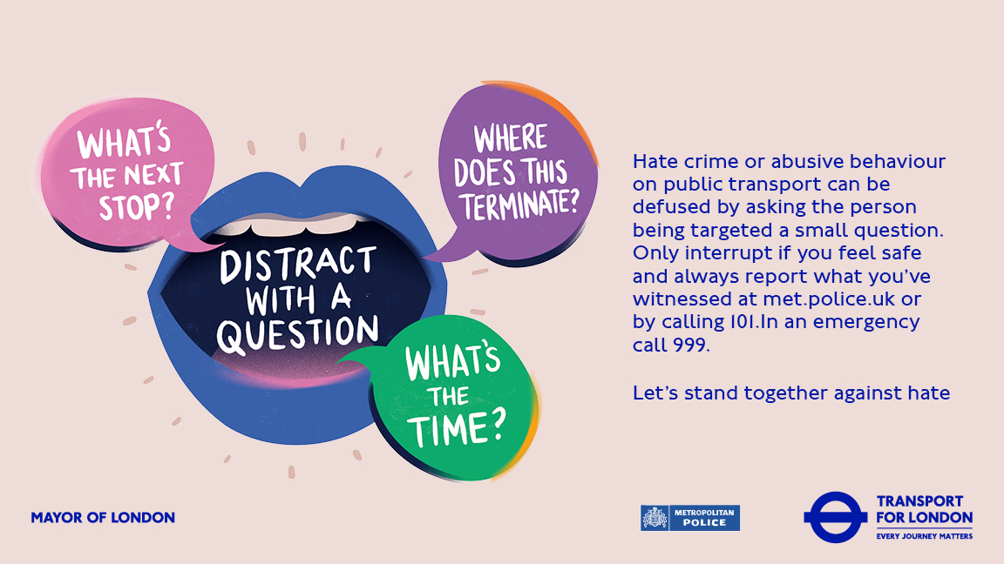
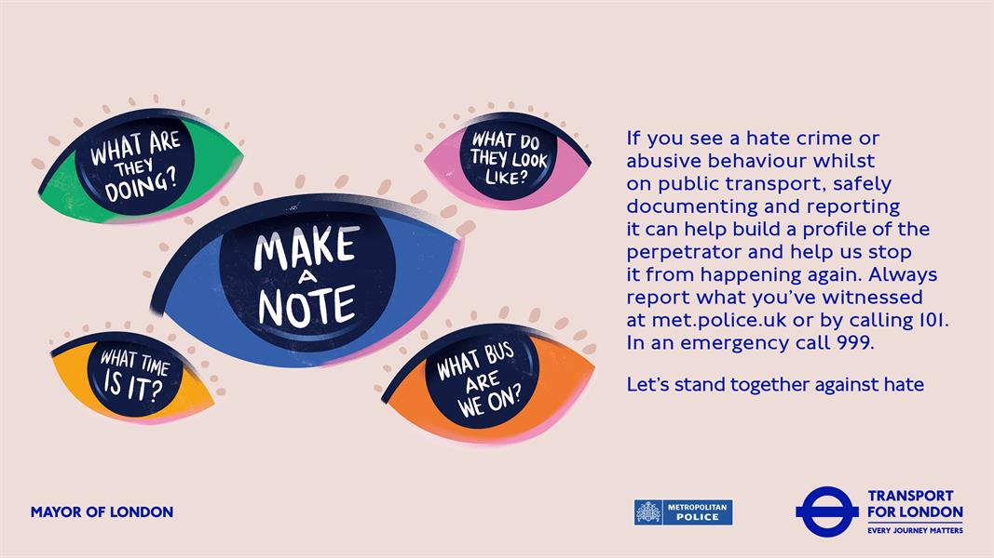

Slide 21
Your Safety
When you are deciding your next move as to how to support victims of harassment, your safety is a large consideration – your build, height, gender, race, upbringing etc. can impact whether you feel comfortable choosing a direct or an indirect form of intervention
Especially in a situation where other people around may have training, evaluate the situation i.e.
- the person;
- anything you know about them i.e. any history of violence, confrontational attitude,
- whether they have been drinking;
- what time of day it is;
- where you are;
- the people you have around you i.e. managers, security; college staff, your friends,
- the nature of the situation;
- resources i.e. do you have a phone?;
- your background and how comfortable you feel in dealing with conflict
Notes:
Explain:
Direct Action poses most risk: get trainees to identify these risks
Emphasise the importance of keeping safe
It is vital to remember that no person is ever to blame for sexual assault, rape or harassment other than the perpetrator - It is important that you way up your options and ensure whatever you decide to do doesn’t put you and/or the target in further danger

Slide 22

Scenario 1
You’re out clubbing. You see someone being groped by another person on the dancefloor, they seem to try to move away, but the person follows.
What can you do?
oxfordsu.org
Notes:
Scenarios (20 mins) slides 21-24
Ask attendees to pair up. Go through each scenario and ask them to consider it in relation to the following questions:
- Would you feel comfortable intervening? If not, what prevents you from intervening here?
- What strategies could be used for this scenario?
- How does the identity of the harasser/ target/ intervener change/complicate responding to this scenario?
For each scenario – 2 mins on discussion in pairs and 3 mins on feedback.

Slide 23
Scenario 2
You are at lunch with your coursemates and one of your coursemates starts making rude gestures and comments directed towards another student at lunch.
What can you do?
Notes:
Scenarios (20 mins) slides 21-24
Ask attendees to pair up. Go through each scenario and ask them to consider it in relation to the following questions:
- Would you feel comfortable intervening? If not, what prevents you from intervening here?
- What strategies could be used for this scenario?
- How does the identity of the harasser/ target/ intervener change/complicate responding to this scenario?
For each scenario – 2 mins on discussion in pairs and 3 mins on feedback.

Slide 24
Scenario 3
You are at your friend’s house when their partner comes home. Their partner is upset with your friend and begins shouting at them, causing you to wonder whether your friend is in an unhealthy relationship.
What can you do?
Notes:
Scenarios (20 mins) slides 21-24
Ask attendees to pair up. Go through each scenario and ask them to consider it in relation to the following questions:
- Would you feel comfortable intervening? If not, what prevents you from intervening here?
- What strategies could be used for this scenario?
- How does the identity of the harasser/ target/ intervener change/complicate responding to this scenario?
For each scenario – 2 mins on discussion in pairs and 3 mins on feedback.

Slide 25
Scenario 4
You are walking down the street when you notice a couple up ahead. They are being confronted by someone, who is shoving them and shouting homophobic slurs and threats at them
What can you do?
Notes:
Scenarios (20 mins) slides 21-24
Ask attendees to pair up. Go through each scenario and ask them to consider it in relation to the following questions:
- Would you feel comfortable intervening? If not, what prevents you from intervening here?
- What strategies could be used for this scenario?
- How does the identity of the harasser/ target/ intervener change/complicate responding to this scenario?
For each scenario – 2 mins on discussion in pairs and 3 mins on feedback.

Slide 26
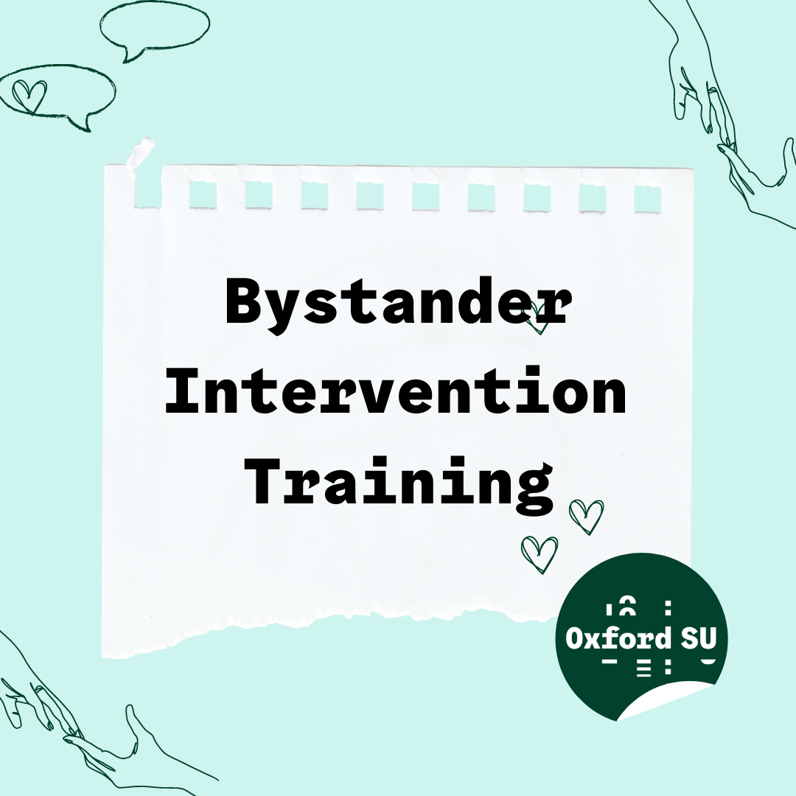
Thank you!
Feedback, Links and Resources
Notes:
Powerpoint on bystander community page on Facebook

