Slide 1

Diversity Training
Notes:
Introduce yourself with name and pronouns and if you hold a position in your common room / are a peer supporter
Encourage people to ask questions throughout, but let them know they can ask at the end to or email yourself/common room rep/ SU
Housekeeping – let people know where the nearest toilets are (preferably gender neutral and accessible), let people know where they can get water
Normalise leaving- if a person wants a break / the toilet etc they don’t have to ask/ put their hand up
Let people know about the break out space nearby

Slide 2
Notes:
Visual representation of privilege
Two people can be running the same distance but because of their different identities and subsequent privilege or lack of privilege they experience the journey very differently, thus one race can be made harder than the other
We could ask the participants to think about what's blocking the woman's path:
Misogyny
Racism
Potential classism / ableism?
E.g.- assumption women are not meant to be succeed in corporate environments, people of certain races are less intelligent resulting in tutors not providing challenging opportunities, lack of opportunity in area growing up like a ‘good’ school, inability to get a job as easily because companies won’t make reasonable requirements for a person’s disability

Slide 3
Trigger Warning:
Suicide and hate crime
Notes:
Everyone always has more to learn, including us as facilitators) – emphasise that no one can ever know everything about everything and when it comes to identity politics and discrimination there is always more to learn especially given the changing landscape
Unconscious bias is a problem and it is important to acknowledge it so you can challenge it
Discrimination and oppression based on identities exists
Racism exists
Ableism exists
Queerphobia / homophobia exists
Classism exists
Transphobia exists
Ignorance can and should be addressed – we are not here to shame people for getting stuff wrong or not knowing things, it is inevitable that people will have gaps in knowledge especially if you went to school were different identities weren’t talked about or celebrated. We are here to learn and not let ignorance be reason we operate in discriminate and / or oppressive ways – everyone can learn more and we all should make the effort

Slide 4


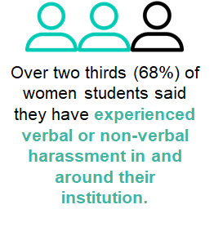
Statistics
60%
Racist incidents at UK universities have risen more than 60% in two years (2018)
Almost 3 in 4 people living with autism and learning disabilities have experienced hate crime
39.5% of Oxford students come from fee paying education whereas only 7% of school children actually attend independent schools
78%
Between 2016-17 year there was a 78% increase on 2013 in the number of LGB people who experienced a hate crime or incident because of their sexual orientation
More than two in five trans young people have attempted to take their own life (2015)
Notes:
Go over the stats
This shows us why we are here
Citations:
https://www.ox.ac.uk/about/facts-and-figures?wssl=1 https://www.isc.co.uk/research/
https://www.stonewall.org.uk/media/lgbt-facts-and-figures
https://www.independent.co.uhttps://www.stonewall.org.uk/media/lgbt-facts-and-figures
k/news/education/education-news/racism-uk-university-students-campus-nus-incidents-a8390241.html
https://www.mentalhealth.org.uk/news/new-report-shows-people-learning-disabilities-are-high-risk-targeting-hate-crime-yet-remain
NUS Hidden Marks Survey

Slide 5
Why we are here:
Living together as a diverse student community
Considering the experiences of all students
Understanding concepts and terminology
Practical tools to become allies
Everyone has more to learn – including your facilitator!
What’s one thing about diversity that you find confusing?
Notes:
Learn about different identities and how to be accommodating in a diverse space
Understand terminology concerning different identities and experiences Everyone has more to learn – including the facilitator!
Be more aware of discrimination and oppression and how you can challenge it
emphasise that no one can ever know everything about everything and when it comes to identity politics and discrimination there is always more to learn especially given the changing landscape
We are going to discuss racism, classism, sexism, ableism, and homophobia, with mention to how these issues can intersect
Emphasise that this is not an exhaustive list of identities or experiences or oppression/discrimination but an introduction and people should always strive to learn more
We are going to discuss different forms of prejudice and how this results in systemic obstacles and oppression for different groups/identities. It is important to remember that this is not a catch all training – the groups we are going to talk about consist of individuals. We are primarily trying to highlight how we can accommodate different identities and make the university an accessible, diverse environment.

Slide 6






Expectations
Confidentiality
Listening
Discussion not Debate
Respecting Others
Ask Questions
Use Trigger Warnings
Notes:
We have ground rules so we can have a productive and respectful discussion
Respectful discussion- don’t talk / shout over people, debate/challenge the point not person
Listen – especially to people’s first-person experiences, we are not here to debate a person’s lived experience of ‘X’ discrimination but listen and learn and discuss it in relation to wider oppression and how we can tackle it
Confidentiality: Don’t leave the session and gossip nastily about people’s questions- this is a space for open discussion and all questions are welcome, the questions one might think are ‘dodgy’ are probably the most important questions
Triggers: If discussing or bringing up particularly sensitive issues or using derogatory language please ask participants to use trigger warnings
Discussion not debate – we are here to discuss intersectionality and discrimination NOT debate whether it exists or is important, we are here to learn more

Slide 7
Key Concepts
Discrimination
Unconscious bias
Microaggressions
Privilege
Intersectionality
We are going to discuss these concepts in the context of different identity groups to help you understand how they work!
Notes:
These are some of the key terms and concepts that we are going to cover. Some of them are types of behavior that can create oppressive environments and others are concepts that…
Discrimination, prejudice and bias exist in different forms, which can intersect and result in levels of oppression and privilege
Discrimination: when people act on a prejudice which causes certain groups to be disadvantaged (economic, social, cultural capital) in relation to others. It can be direct or indirect.
Unconscious bias: a prejudice that people hold against a certain group that impacts their behaviour and attitude towards that group. This behavior can lead to discrimination and it is often not intentional/conscious. For example, implicit stereotyping and unconscious organization. For example, Oxford college porters stop black students but not their white peers, because they think they do not attend the college/university.
Microaggressions are the everyday verbal and nonverbal actions and comments that communicate hostile, derogatory, or negative messages to a person based on them being part of a certain group. They can be intentional or unintentional. Microaggressions accumulate and can result in someone feeling isolated, inferior and affect their mental health.
Privilege: aspects of a person's identity which do not result in prejudice against them– this does not mean to say that anyone has had it 'easy’. Discussions about privilege should not revolve around comparing who is the most privileged, but it is important to recognize that certain groups experience barriers to access that others do not.
Intersectionality: Refers to how individuals can face multiple levels of discrimination and privilege when their identity crosses over different groups. We will discuss this in more detail later in the training

Slide 8
Racial Diversity
Notes:
Title slide

Slide 9
“ I don’t even see race”
Everyone sees race, even when its unconscious
Racism is often covert
Refusal to acknowledge racism
Notes:
Explain why this is a problematic statement
The refusal to acknowledge race also means you are refusing to acknowledge racism and the structural oppression it brings. Racism is not just about people saying hateful things.
Present day racism is not as ‘in your face’ in a lot of sense, people are less likely to out-right say they support the KKK or refuse to speak to people of a certain race HOWEVER racism manifests itself in more subtle ways. That is not to say the more overt stuff doesn’t happen!
In reality, Race is all around us – built into the values of our institution (the traditions and visibility), our curriculum (who you study and their perspectives), which both influence our behavior and stereotypes. So actually race is everywhere, and it has become a part of the way we categorise and process information.
Highlight that this includes Islamophobia and anti-Semitism.

Slide 10
Unconscious Bias
A prejudice that people hold against a certain group that impacts their behaviour and attitude towards that group. This behavior can lead to discrimination.
Can you think of any examples?
Notes:
Definition:
a prejudice that people hold against a certain group that impacts their behaviour and attitude towards that group. This behavior can lead to discrimination and it is often not intentional/conscious. For example, implicit stereotyping and unconscious organization.

Slide 11
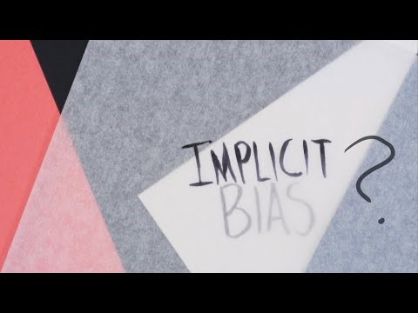
Notes:
Play video
Maybe explain that implicit = unconscious

Slide 12
Racial Diversity
Unconscious Bias
Being stopped at the porters' lodge
Selecting or avoiding students with certain names
Choosing not to sit next to anyone that looks ‘aggressive’ or ‘suspicious’
How does this lead to feelings of exclusion?
Notes:
Example:
Oxford college porters stop black students but not their white peers, because they think they do not attend the college/university.
Often, porters do not think, wow this person is black I don’t want them in my college. Instead, they have
How about avoiding the south Asian person on the bus because they look ‘suspicious’.
Discuss how this leads to feelings of exclusion:
Makes university space exclusive/more accessible to white students – harms diversity, can impact people’s studies, social life and mental health

Slide 13




Racial Diversity
Being Inclusive
Challenge your own thoughts and educate yourself
Ask
Questions – but don’t just refer to your friend of colour all the time!
Don’t overcompensate
Promote racial diversity in your activities, but no cultural appropriation
Notes:
Practical ways to be inclusive:
1) While bias is often acted on unconsciously, you can often identify an issue once done. Build relationships with people you’ve been socialized to see as not valuable to be in relationships with, learn new information. Educate yourself and take the time to send others resources, too.
2) be respectful and ask questions. Maybe introduce that you’ve been thinking about a few things and would appreciate if they could answer some questions to clarify the reality of people of colour – BUT don’t ask your friend of colour to explain things you could research yourself.
3 If you make a mistake or get called out, apologise and move one but don’t make things awkward by over-apologising – instead use the time to educate yourself!
4) Get people involved, especially when thinking about cultural and racial activities. Cultural appropriation is the misuse of another culture for your own benefit. We’re not going to talk about it now, have a google search in your own time or speak to your college BAME Rep. If you’d like to do something for Black history month ensure your BAME rep is part of the conversation. If you’d like to run a themed ball, speak to your BAME Rep. If you’d like to do something for international students, speak to the BAME and international Rep. Don’t settle at mere consultation, make them key decision makers and part of the creative process.

Slide 14
Disability and Diversity
Notes:
Title slide

Slide 15
Disability and Diversity
What is a disability?
Under the Equality Act 2010, having a disability is defined as:
Having a physical or mental impairment (including mental health condition and specific learning difficulties).
The impairment has a substantial and long-term adverse effect on their ability to carry out normal day-to-day activities.
If someone doesn’t have a diagnosis, does this mean they don’t have a disability?
Not all disabilities are visible
Notes:
Go over the definition from the Equality Act 2010
Ask them to think about whether a diagnosis is required for a person to have a disability
Reference that getting a diagnosis can be harder for certain people
E.g. women’s pain is more likely to be ignored by medical professionals
E.g. people of colour, specifically black people are less likely to get diagnosed at early stages and are more likely to suffer or even die because of not being taken seriously by medical professionals
Not all disabilities are visible
Its important to think about disability because so many of our structures exclude disabled people from

Slide 16

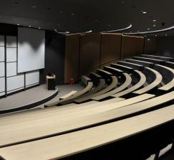
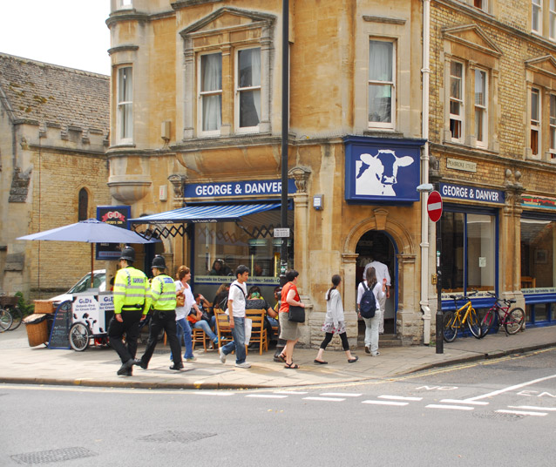
Disability and Diversity
Experiences
Notes:
Hogwarts hall in Christchurch – lots of stairs not accessible for lots of people not just wheelchairs
Hearing loop in a lecture – lack of choice on where you can sit
G&Ds, Cafe or pub - Really busy, they’d have to find somewhere else to go, miss on social life and integration.

Slide 17
Discrimination:
Acting on a prejudice which causes certain groups to be disadvantaged in relation to others. It can be direct or indirect.
Can you think of any disability-specific examples?
Notes:
Definition:
when people act on a prejudice which causes certain groups to be disadvantaged (economic, social, cultural capital) in relation to others. It can be direct or indirect. It can be direct, meaning that you treat someone less favourably than another, or indirect meaning the same rule is applied to everyone in the same way but this doesn’t take account of the different ways that people approach/navigate a situation.
For example, holding non-accessible events, this is excluding a group of students due to a characteristic based on a prejudice that they aren’t as important to attend the event. ????

Slide 18
Disability and Diversity
Being Inclusive: Using Appropriate Language
Ask people how they identify
Speak ordinarily in the way you would speak to any adult
People without a disability are
‘non-disabled’ or ‘able bodied’,
not ‘normal’
Avoid comparing disabilities to short term states or emotions, or using disabilities as an insult.
Not everyone wants to be a Paralympian – avoid ‘inspiration porn’
Avoid asking how someone’s disability came to be, or questioning invisible disabilities
Notes:
1) Ask people how they identify personally.
2) Speak ordinarily. Do not change how you speak to individuals with disabilities, in the sense that you shouldn’t speak to an adult with a disability in the manner in which you’d speak to a child. Nonetheless, be willing to make adjustments if asked, such as repeating yourself or facing someone for lip-reading, etc. This doesn’t only apply to people with hearing impairments and may also be relevant for individuals with difficulties regarding information processing (frequently the case with autism).
3) Referring to people who aren’t disabled. Avoid use of alienating terms such as ‘normal’. Generally, ‘non-disabled’ is preferred.
4) Don’t compare disabilities to short-term states or emotions, nor use disabilities as an adjective or insult. For example, do not compare the experience of panic attacks to nervousness before exams, or describe someone as “so OCD”. Also avoid the use of terms such as ‘psycho’ to explain why someone is ‘evil’ – a diagnosis should not be used as an insult.
5) Don’t compare people to famous people with the same disability. Not everyone wants to be a Paralympian; not every person with bipolar disorder identifies with Stephen Fry. The glamorisation of lauding disabled people as ‘inspirational’ because of successes, is often referred to as ‘inspiration porn’.
6) No invasive questions. You may be intrigued about someone’s disability but avoid asking invasive questions (unless you are close friends with a person, or they are offering the information). Invasive questions may include asking how someone’s disability came to be or asking questions about subjects such as disability and intimacy, which has been in the media a lot in recent years. Avoid assumptions such as ‘You don’t look disabled.’ A huge number of disabilities are totally invisible, so don’t assume that you can see disability or that disabilities are always immediately apparent.

Slide 19



Disability and Diversity
Being Inclusive: Etiquette
Don’t engage with assistance dogs
Be willing to help (but take no for an answer too!)
Accessible Social Media
Don’t offer flippant advice
They know more about their disability than you do
Notes:
Practical ways to be inclusive:
1) Assistance dogs can be for numerous conditions, not just visual impairments. Avoid engaging (stroking, feeding, etc.) with assistance dogs who are working, as this can distract them from taking care of their owner.
2) Respect space. Don’t physically touch someone or their equipment (such as a wheelchair) without asking, even if you think you’re being useful!
3) Be willing to help. Offering help is great, but be accepting if people decline.
4) Offering flippant advice, such as ‘have you tried…?’ is not useful! The person knows more about their disability than you, even if you share a condition or know someone who does. Experiences of the same condition can differ significantly.

Slide 20
LGBTQ+ and Gender Diversity
Notes:
Title slide

Slide 21
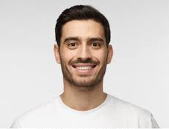
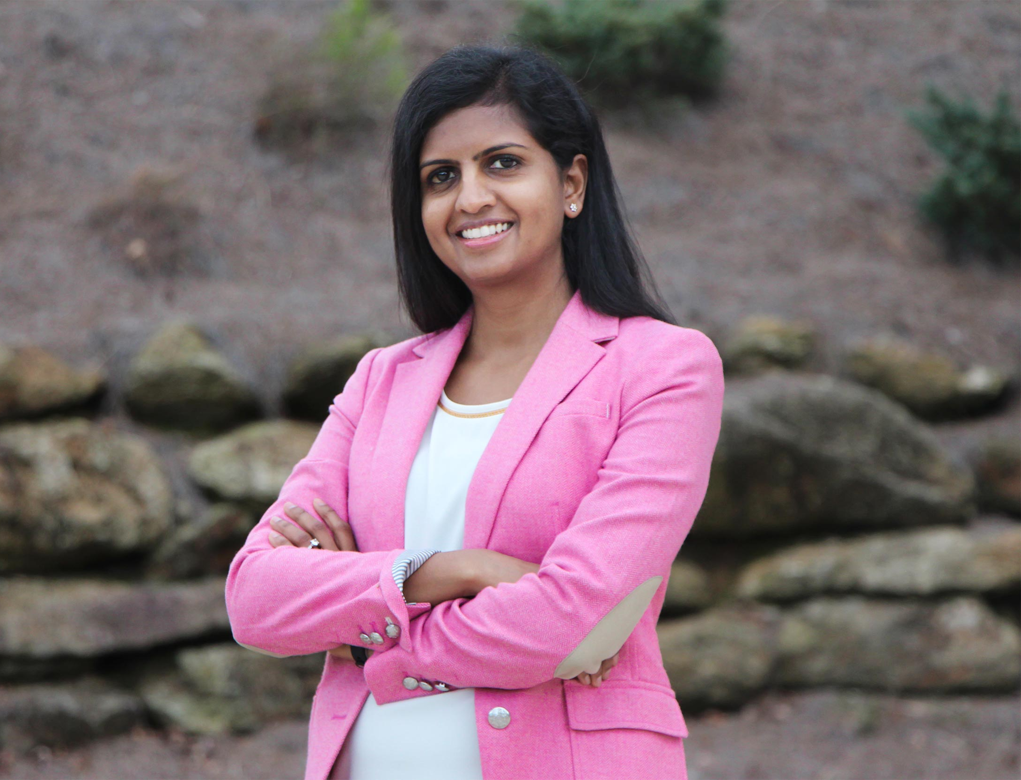
LGBTQ+ Diversity
Hetero- and cis-normativity
Notes:
Have a look at these photos and I want you to think about who you think they are and answer some questions internally, don’t share them with anyone.
How old are they?
What do they enjoy doing?
What does their partner look like?
Highlight that:
People assume certain things on the way they express their gender but actually gender identity is not the same as gender expression – some people (trans, non-binary) do not have the privilege of expressing their gender identity externally.
The way our society is set up is that we are conditioned to think that everyone is heterosexual and that that’s the best way to live.

Slide 22
Heteronormativity and Cisnormativity
The assumption, in individuals or in institutions, that everyone is heterosexual and cisgender and that these identities are superior to other sexualities and genders.
Notes:
‘Heteronormativity​’
The assumption that everyone is heterosexual and that beign straight is ‘normal’ or ‘natural’​
Cisnormativity​
The assumption that everyone is cisgender and that being trans is ‘abnormal’ and ‘inferior’​
Mention that the World Health Organisation only recently (May 2019) stopped recognising being trans as a ‘disorder’​
Orientation describes what genders, if any, you’re attracted to.
Sexual and romantic attraction are different and may not always align.
Some people experience neither.
Some people go through a period of questioning.
Not a choice.
Not a phase.
The LGBTQ+ Acronym is useful for exploring some of these.

Slide 23
LGBTQ+ Diversity
The Acronym
L Lesbian
G Gay
B Bisexual
T Trans
Q Queer
I Intersex
A Ace
P Pansexual
Notes:
Go through the acronym
L Lesbian
A woman who is attracted to women
G Gay
A man who is attracted to men, however, gay is used interchangeably regardless of gender sometimes
B Bisexual
An umbrella term used to describe a romantic and/or sexual orientation towards more than one gender.
T Trans – we’ll come back to this one
Q Queer
A term used by those wanting to reject specific labels of romantic orientation, sexual orientation and/or gender identity. It can also be a way of rejecting the perceived norms of the LGBT community (racism, sizeism, ableism etc). Although some LGBT people view the word as a slur, it was reclaimed in the late 80s by the queer community who have embraced it.
I Intersex
A term used to describe a person who may have the biological attributes of both sexes or whose biological attributes do not fit with societal assumptions about what constitutes male or female.
A Ace
Ace is an umbrella term used to describe a variation in levels of romantic and/or sexual attraction, including a lack of attraction. Ace people may describe themselves using one or more of a wide variety of terms
P Pansexual
Refers to a person whose romantic and/or sexual attraction towards others is not limited by sex or gender.
Emphasise that this acronym is not the only one and many people don’t identify with the acronym – this is ok!
We use this acronym because it is most widely known within this society
Usually the acronym is shortened to LGBT or LGBTQ+
Some of these are umbrella terms

Slide 24
Gender Diversity
What is Gender?
Sex Assigned at Birth
This is decided based on a persons genitals
and sex organs. People can have a mixture or
variation, these people are known as intersex
Gender Identity
A person’s internal sense of being a gender
Not binary, fixed, limited, or the same as sex.
If a person’s gender identity is not the same as the
one assigned at birth, they are transgender.
Gender Expression
How a person presents themselves
Can change daily, doesn’t necessarily ‘match’
with gender identity
Notes:
Gender is often thought by people to be how a person dresses and what sex organs they have
In reality gender is about how a person defines and that exists separately to gender expressions and sex assigned at birth
Gender identity is how a person feels and identities
A persons internal sense of being a gender
It is a personal definition that relates to how a person perceives themselves
We live in a society that assumes that everyone identifies with the gender they were assigned at birth and that this way of identifying is superior to others. In reality, people identify in lots of different ways.
Gender identity is not
Binary – not just man or woman.
Fixed – some people are gender variant or fluid
The same as sex – it has nothing to do with what is in a persons pants!
Limited – throughout history we have seen cultures all over the world recognise different genders. ‘Two-spirit’ – an identity and term used by Indigenous folk, First Nations and Native Americans who possess masculine and feminine spirits AND ‘Hijra’ – a term and identity used in South Asia for trans folk i.e. ‘Even though a person may go through a time of questioning this time should not be dismissed as a phase or something to ‘grow out of’
If a person’s gender identity is not the same as the one assigned at birth, they are transgender. The term ‘Trans’ can be used as a catch all term describing gender identities other than cisgender
Gender expression is how person presents themselves
This is how a person presents themselves visually
It can change as often as daily
This can be because a person’s gender identity fluctuates so they want their expression to reflect that
It can also be because a person has to conform to a dress code which doesn’t allow them to express themselves how they like
Shown usually through clothes, make up and/or prosthetics
Many people do not have the privilege of expressing their gender identity visually, this can be for a number of reasons: not being out, having to conform to a dress code, being in a ‘professional’ job which requires gendered dress etc HOWEVER this does not mean their gender identity changes
Some words associated with gender expression: masculine, feminine and androgynous
Sex assigned at birth is a person’s sex organs
Decided at birth based on a person’s genitals and sex organs
Primary sex organs are testis or ovaries = male or female respectively
Genitals are external sex organs, also known as secondary sex organs: penis and scrotum or a vulva
HOWEVER people can have a mixture or a variation of both internal and external and these people are usually known as intersex
Intersex people are born with sex characteristics that do not fit the typical binary notion of male or female
This can be a mix of chromosomes, genitals and gonads
Some are apparent at birth, some not until puberty
Being intersex relates to biological sex characteristics and is distinct from gender identity, gender expression and sexuality
Intersex people are often subjected to human rights violations including violations to their rights to health and physical integrity
Intersex people are NOT the same as trans people – however
There are two terms that are used a lot to refer to the erasure and discrimination LGBTQ+ folks experience
Heteronormativity
The assumption that everyone is heterosexual and that beign straight is ‘normal’ or ‘natural’
Cisnormativity
The assumption that everyone is cisgender and that being trans is ‘abnormal’ and ‘inferior’
Mention that the World Health Organisation only recently (May 2019) stopped recognising being trans as a ‘disorder’

Slide 25
Microaggressions
Microaggressions are the everyday comments and actions that communicate hostile, derogatory, or negative messages to a person based on their group identity. Even if there is no intent to offend, it is still a microagression.
We’ll look at some examples later.
Notes:
Microaggressions are the everyday verbal and nonverbal actions and comments that communicate hostile, derogatory, or negative messages to a person based on them being part of a certain group. They can be intentional or unintentional. Microaggressions accumulate and can result in someone feeling isolated, inferior and affect their mental health.

Slide 26
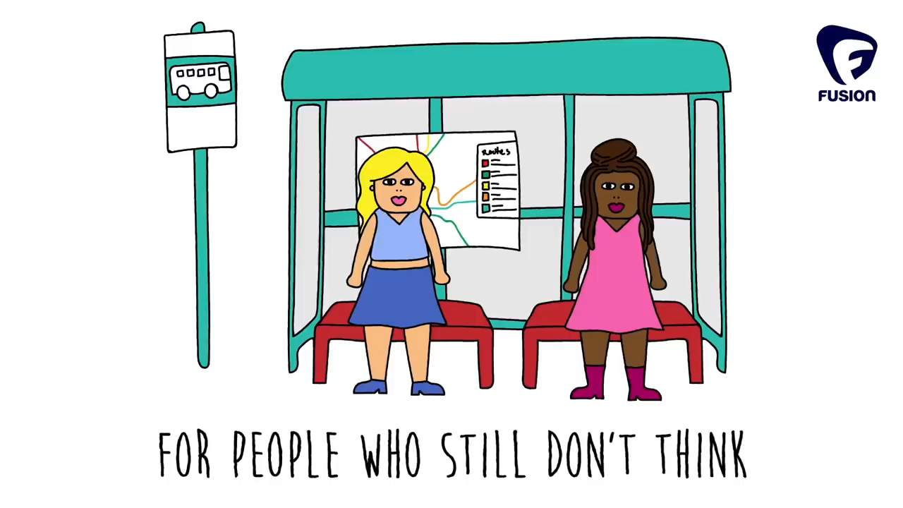
Notes:
Play the video

Slide 27
LGBTQ+ and Gender Diversity
Microaggressions
“Wow, your skin is better than a real woman”
“You’re so beautiful, I didn’t know you were trans.”
“You are so lucky! You’ll never suffer from PMS”
"What she's trying to say is…”
“You should smile more!”
“Is it that time of the month?"
“He’s my gay best friend”
Notes:
Discussion activity
Each table to take a comment and discuss the underlying value/presumption with each statement, before feeding back to the group.
In essence, Misogyny and Transphobia is not always direct or intentionally malintended. It is behavior centred in prejudice and refusal to accept a person as they are and equal to you.

Slide 28

LGBTQ+ and Gender Diversity
Being Inclusive
she
they
he
theirs
them
Use correct pronouns and names, and introduce your own
Avoid objectification and encroaching on personal space
Be careful posting on social media
Challenge your own thoughts
Notes:
1)Use correct Pronouns:
Not just she/her and he/him
They/them is a common pronoun and has been used to refer to a singular pronoun for hundreds of years, famous users include Shakespeare, Chaucer and Jane Austen
Changing pronouns or name can be a scary decision so if someone does and asks you to use new ones, make an effort to do this, you may forget or make a mistake – this is ok, as long as you are making a concerted effort
Misgendering = using the wrong pronouns – this can be deliberate or not, deliberately using the wrong pronouns for a person is a form of harassment under University policy
Deadnaming = using a persons ‘old’ name, typically the one they were assigned at birth
If you are a cis person you can introduce yourself with your pronouns to normalise the act and to infer to trans folk that they are welcome to also do so
2) Avoid objectification and encroaching on personal space –
3) Be careful posting on social media – not every person wants to post their personal information all over the internet. It could have implications for their family life, career, social life at uni, because actually people still discriminate.
4) Challenge your own thoughts… before you speak, what does this comment or ‘compliment’ really say about the person.

Slide 29
Class Diversity

Slide 30
What is privilege?
Aspects of a person's identity which do not result in prejudice against them
This does not mean to say that anyone has had it 'easy’
Some groups experience barriers to access that other do not – we will look at this in terms of class

Slide 31


Class Diversity
Privilege
£
Economic:
Our access and knowledge
Social:
Our connections
Cultural:
Our experiences
Notes:
Structural inequality and the existence of class systems means that those at the lower end of what is referred to as the social scale (working-class, blue collar professions) face not just financial but social and cultural difficulty. We will discuss these three concepts in more detail in the next slide with an aim of highlighting class-based privilege and oppression.
It is important to highlight that class issues can and do intersect with some of the other forms of discrimination we have talked about in various ways:
The intersection of class with race results in certain stereotypes about low-income people of colour, resulting in the creation of disadvantaged areas which are majority PoC – again resulting in stereotypes such as ideas about 'ghettos' which can further discrimination
The intersection of disability and socio-economic disadvantage can present further barriers to access
This is not exhaustive and there are many more examples
Economic
Here we’re talking about a persons access to finance and also their knowledge of financial institutions and how to acquire and preserve wealth for themselves and future generations.
Social
The sum of resources available to a person because of their relationships with other people: family, friends, mutual acquaintances
These are known as ‘good connections’
Examples could include
Having a family member who has studied at Oxford, this means you may get help with the admissions help.
Finding an internship / placement through someone you know, like if your dad is high up in a corporate company and is able to get you a good internship others wouldn’t have access to
Cultural
This is the skills and knowledge a person may gain due to their educational, family or class background
These skills and knowledge are well respected in society
Examples of this could include:
Knowledge of Latin or Greek – this can give you an advantage when coming to University, especially Oxford
Familiarity with art and literature – this could be having been taken to museums and galleries as a child and having ‘intellectual’ conversations – this can give you an advantage when coming to Oxford as you are often put in situations where you have to engage in small talk and if you are not accustomed to this it can be quite unnerving
Being ‘well spoken’, this can specifically relate to having an accent that is different to received pronunciation – for example a northern accent.

Slide 32
Class Diversity
Privilege
1My accent and the words I use are considered ‘well-spoken’
2 My school had plenty of resources, like books and sports equipment
3 The neighborhood around my home is safe
4 My family have intellectual conversations at the dinner table each night
5 I don’t have to work during the vacation
6 I can do unpaid internships in the vacation
7All of my siblings went to Oxbridge and helped with my application
8 I have used a social connection to get a job or get advice about my future career choices
Notes:
Pick two numbers between 1-8. Read the corresponding experience and put yourselves in the shoes of that experience. Think about how these things correspond with a attribution or lack of privilege in the areas we discussed and how that could make a difference to someone’s university experience.
Oxford specific examples:
Going to formal hall
Building connections at career networking events
Securing work experience

Slide 33
Class Diversity
Privilege
How can people with class-based privileges affect society in ways which people without privilege cannot?
Notes:
Potential follow up question if time: How can people with class-based privileges affect society in ways people without privilege cannot?

Slide 34
Class Diversity
Being Inclusive
Don’t react with surprise and judgement
Think about how group or college activities may affect your peers financially
Learn about their experiences rather than expecting them to adapt to middle-class values
Notes:
Don’t react with surprise and judgement where there are misunderstandings or your friend doesn’t understand a cultural reference – your background isn’t the only experience, they haven’t missed out or been hiding under a rock. Learn about their experiences, jokes etc, rather than expecting them to adapt to the middle-class values of Oxford university. Working class experiences aren’t of lesser value. Be patient when they ask questions
Think about proposing financially difficult activities: don’t assume that people can afford expensive things, and try to think of inclusive alternatives
Learn about experiences: educate yourself, rather than allowing middle-class values to be the norm

Slide 35
Calling Out and
Solidarity
Notes:
Now that we have looked at different forms of discrimination, we will talk about how we can be good allies and accommodate people of different identities within the university context!

Slide 36
Calling Out and Solidarity
Calling out others
Being called out
1
1
Consider the environment
Listen and thank them
2
Identify that what they did or said was offensive and explain why
2
Acknowledge you may have offended someone
3
3
Suggest an alternative
Educate yourself
Notes:
Calling out others
Calling out in the moment
Denouncing what the person is saying
Questioning their behaviour
Point out that such thoughts can contribute to discrimination
Support others who speak up
Calling out afterwards
Follow up or ask a friend to
Send them helpful resources
If they continue to display unacceptable behaviour you can always report them
Getting called out
Listen and thank them! It is not a personal attack and doesn't make you a bad person. The person calling you out has taken time and energy to educate you
Recognise that your intent is less important than the impact
Acknowledge that you may have offended someone and apologise
Don't make it into a huge deal and over-apologise – instead take the time and energy in educating yourself
You can always change your behavior and this is a good thing for everyone – no one is perfect or born 100% woke!

Slide 37
Calling Out and Solidarity
Scenario
Aditya is non-binary and uses they/them pronouns. While you are speaking about them to your friend, Ryan, Ryan points out that you have just misgendered Aditya accidently.
Notes:
How should we react to being told we have used the wrong pronouns?
Say sorry, quickly move on using the correct pronouns (especially important if you are in the presence of the person).
Don’t make a big deal out of it, such as by apologising profusely or complaining about how difficult it is for you to adjust to new pronouns.
What should you do if you don’t know someone’s pronouns?
Ask them! E.g. offer your pronouns and ask theirs

Slide 38
Calling Out and Solidarity
Scenario
You suggest to your friends that you all buy tickets to Wadham Ball. At £169 per ticket it's cheaper than some of the other colleges. Your friend says that they cannot afford that much money, so you tell them that relatively it's quite cheap! They say that they aren't interested and leave.
What do you do?
Notes:
Recognise that you have proposed an expensive event which is inaccessible for some
Your friend likely felt uncomfortable – this is often the case when spending large amounts of money is the norm, as it is with balls
Just because they didn't go into detail doesn't mean that they aren't upset
Check up on your friend – acknowledge that you realise that they may actually not have the money to attend and apologise for dismissing their concern about the cost
You could suggest a cheaper event or an alternative way to spend time as a group which is low/no cost
Be conscious in future that people have access to different resources – it doesn't mean you can't do things but try to be aware that, just because you can afford it, doesn't mean that it's affordable

Slide 39
Calling Out and Solidarity
Scenario
You’re helping to organise a welfare event in college. After you’ve advertised it on your JCR a student messages you to ask if this room has step free access. The room you booked is up a staircase with no lift, but you know this student does not have a wheelchair.
Notes:
Accessibility must be a priority
You should always make the effort to have step free access to events – you never know who might turn up (don’t expect people without disabilities to only turn up)
This student doesn’t have a wheelchair – does this mean they don’t have a disability or mobility need? NO – you never know what needs someone may have and many people have invisible disabilities
Some disabilities are worse at some times than others so even if you have seen this person use stairs before this does not necessarily mean they can all / most of the time
If you can’t change the venue – what can you do to include the person
What next?
Try to change the venue
If you can’t, can you make the journey there more accessible for the person – ask them
Can you hold another welfare event close to this one which is accessible
Apologise for not making access a priority

Slide 40








Calling Out and Solidarity
Solidarity
Take time to educate yourself on others' experiences and society structures
Don’t speak over oppressed people, and don’t make it all about you.
Campaign
Notes:
Education – make time to educate yourself and others (as I said google!) don’t always ask your friend from X minority group, it’s not their job to educate you. Don’t be afraid to admit when you’ve messed up, we live in an unequal society so it is very difficult to grow up in it and not subconsciously pick up on oppressive behaviours – but you can refuse to be ignorant!
Listen to experiences of oppressed people – people don’t make them up for fun, if someone is telling you something that has happened to them BELIEVE them Don’t speak over oppressed people – they can talk for themselves and they know their experiences better than you do
Campaign – don’t leave all the work to people from that community, there is power in numbers
You are not the centre of attention – you don’t need to be congratulated for being a good person

Slide 41
Look at your piece of paper – have you clarified your issue?

Slide 42
Name one thing that you are going to action after this session. If you are with a friend agree something that you will stick to together

Slide 43
Thank You! Feedback Form: https://oxfordsu.typeform.com/to/XJeP0j
Contact vpwomen@oxfordsu.ox.ac.uk for further questions or comments!
Training developed in collaboration with:
VP WEO
VP Women
DisCam
LGBTQ+ Cam
CRAE
Class Act
Icons by flat icon, Daniel Bruce
Notes:
Thank participants / audience for their time
Emphasise that everyone has more to learn
Encourage people to educate themselves
Mention bystander intervention training the SU offers

