Slide 1


MOTION UPDATE
Actions taken since CCR Week 3

Slide 2
For each motion, we have identified:
What the key policy mandates are
What success looks like
What resources we need
An implementation plan
Relevant committees to present and raise the motion
Key stakeholders not in committees (societies, RepComs, other university services)
Specific actions/policy targets
How we will engage and update students
Potential resources for Common Rooms

Slide 3
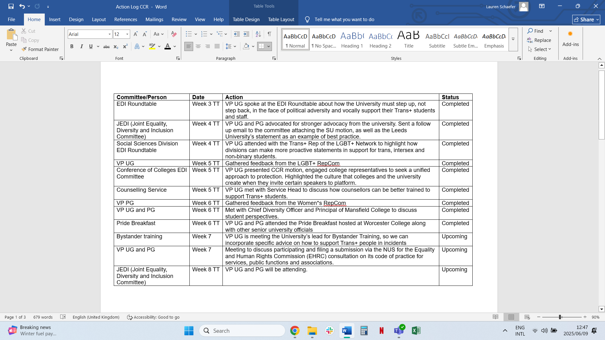
Motion: UK Supreme Court Ruling
Lead Officer: VP UG and VP PG
(President for Welfare Equity and Inclusion)

Slide 4
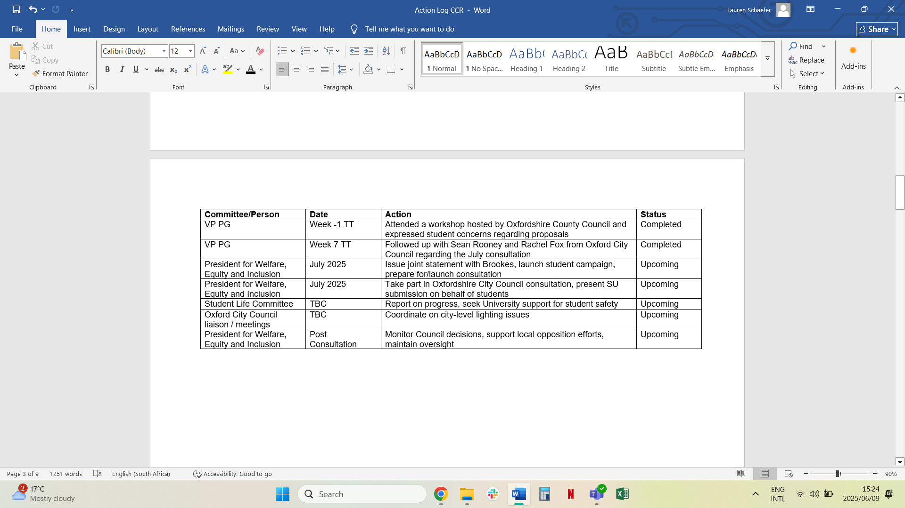
Motion: Dark Skies
Lead Officer: VP PG
(President for Communities and Common Rooms)

Slide 5
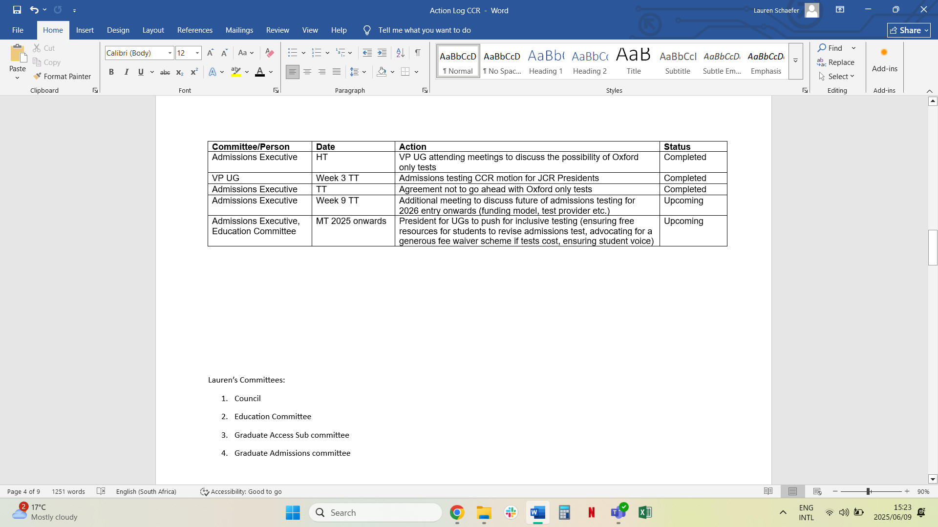
Motion: Admissions Testing
Lead Officer: VP UG
(President for Undergraduate Affairs)

Slide 6
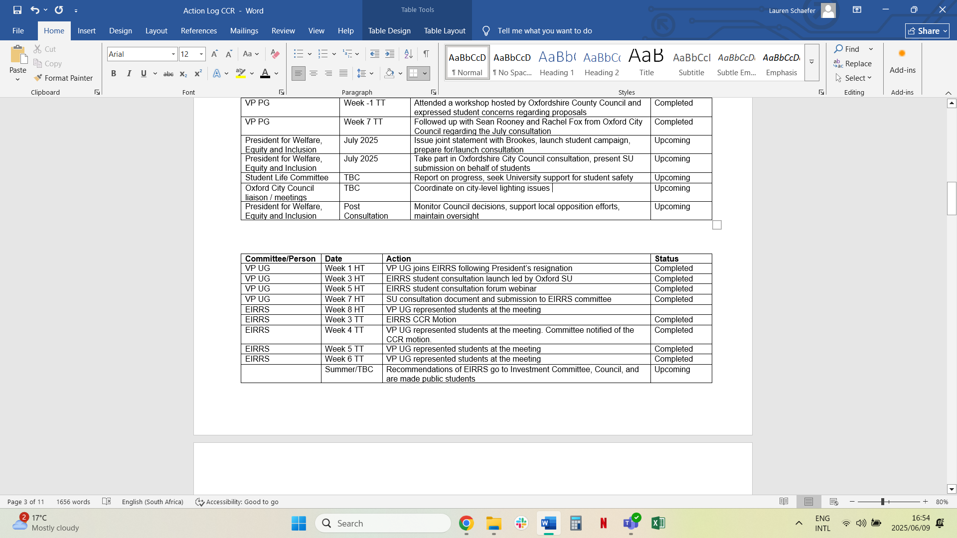
Motion: EIRRS
Lead Officer: VP UG
(President for Welfare, Equity and Inclusion)

Slide 7
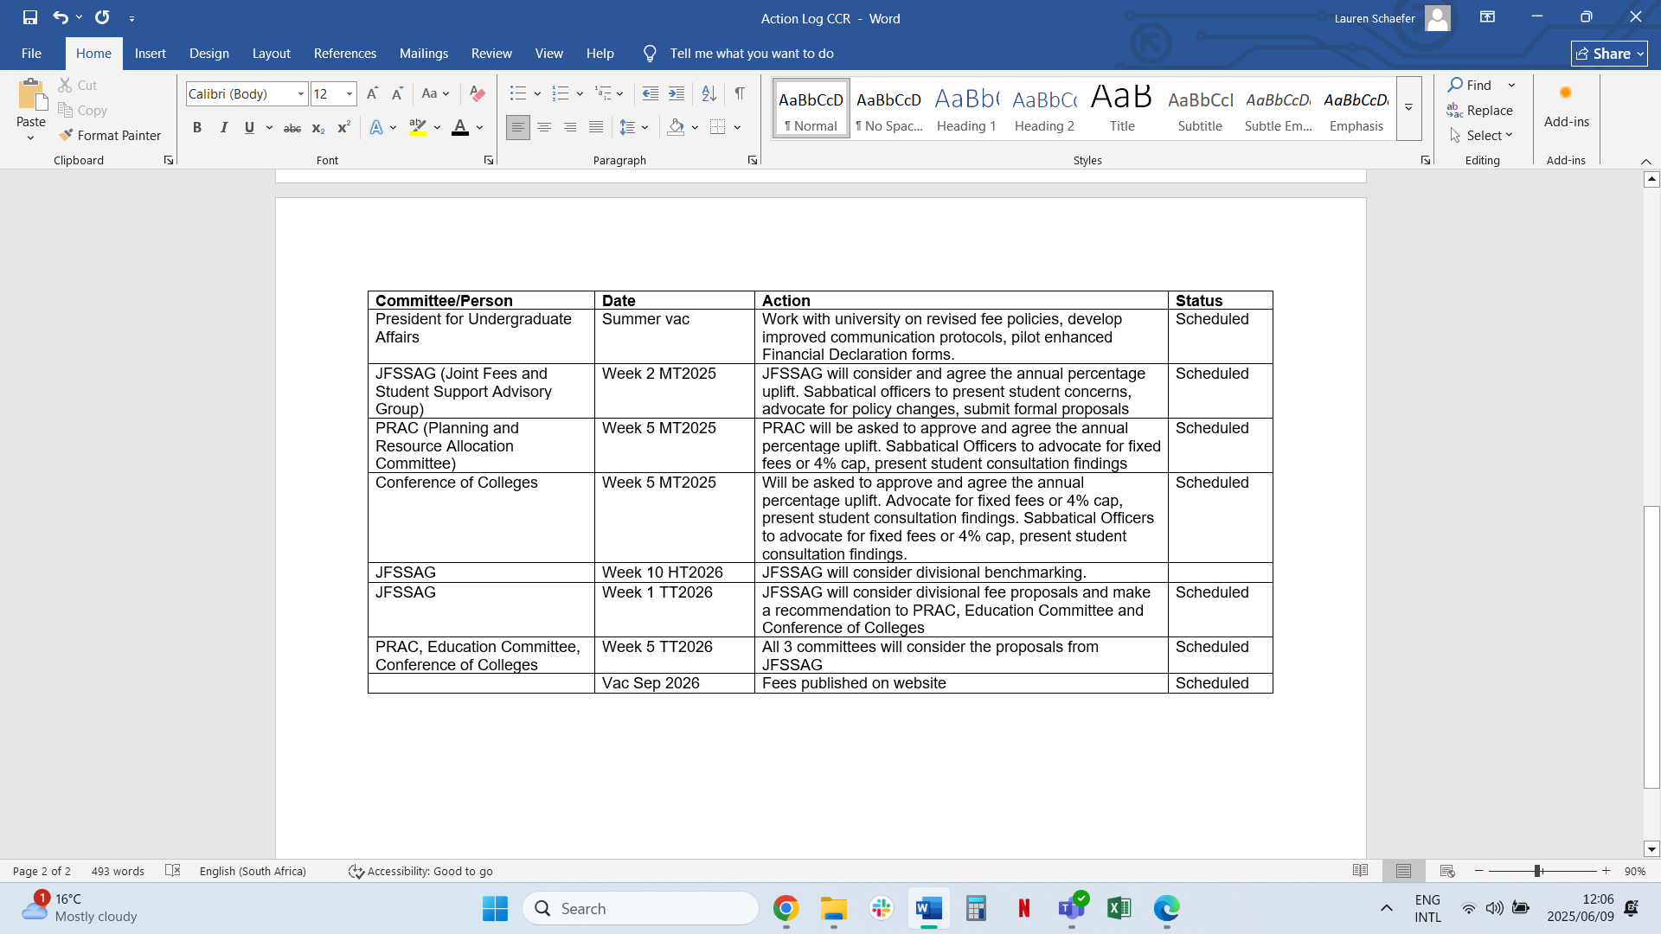
Motion: International Fees
Lead Officer: VP UG and PG
(President for Undergraduate Affairs, President for Postgraduate Affairs, President for Common Rooms and Communities)

