Slide 1

Sabbatical Officer Year in Review
2024/25

Slide 2
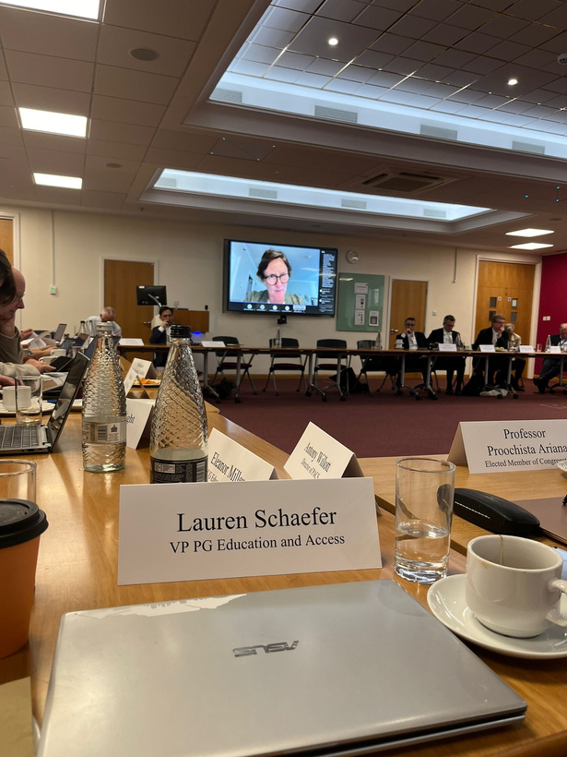
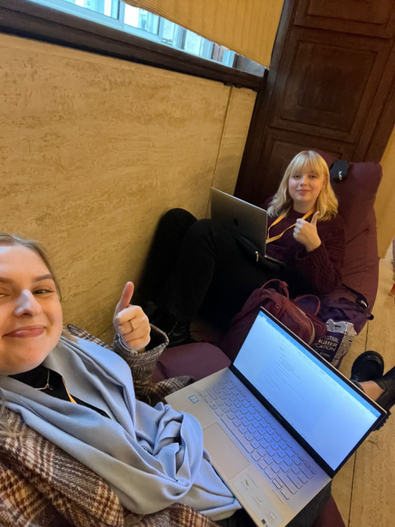
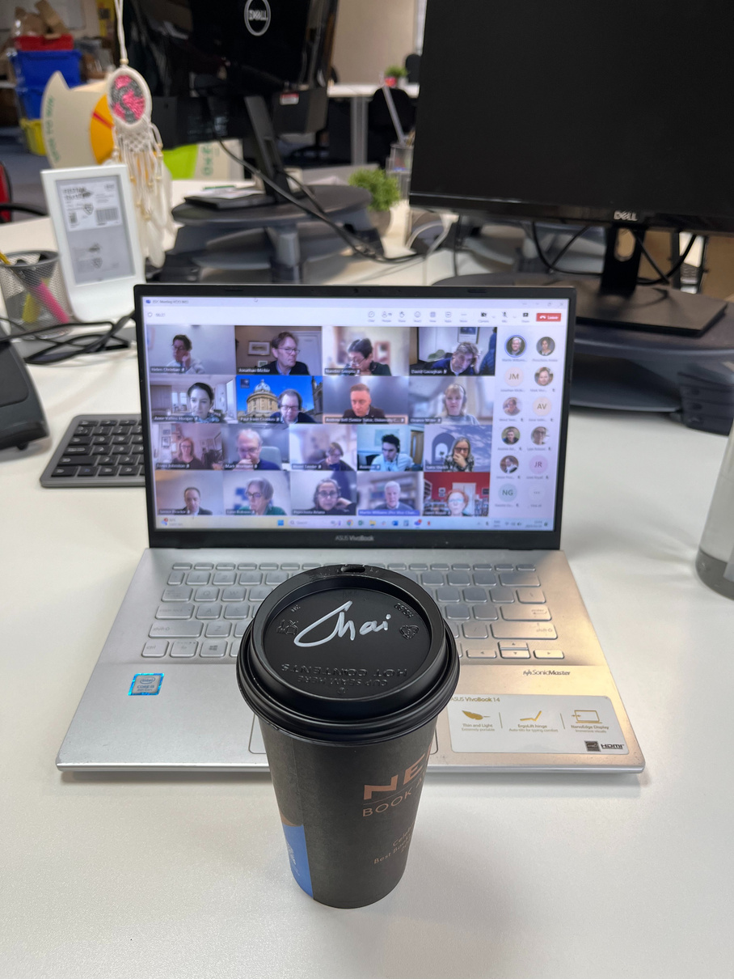
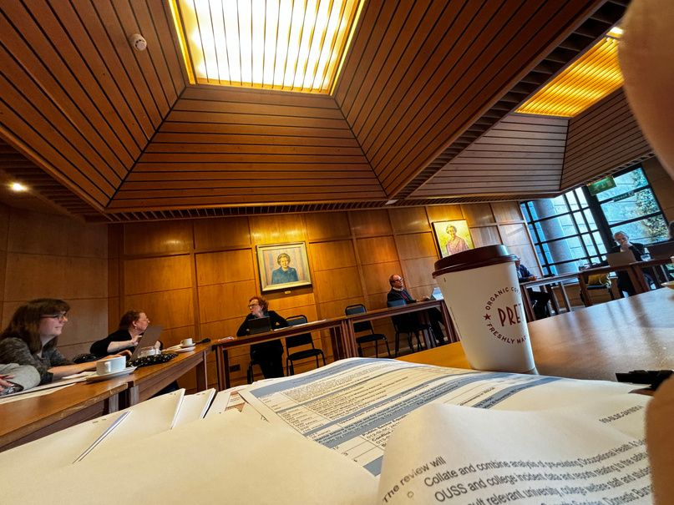
Committee Representation
Eleanor (UG)
  Council
  Education Committee
  Joint Fees and Student Support Advisory Group
  Taught Degrees and Assessment Panel
  Quality Assurance Working Committee
  Admissions Executive
  Admissions Committee
  Conference of Colleges
  Senior Tutors Committee
  Education Portfolio Committee
  Student Life Sub-Committee
  Joint Student Mental Health Committee
  Environmental Sustainability Sub-Committee
  PPH Supervisory Committee
  Forum on Outreach and Access
  EIRRS
  OfS E6 Task and Finish Group
  Second Assessment Sitting Working Group
Lauren (PG)
  Council
  Education Committee
  Graduate Access Sub-Committee
  Graduate Admissions Committee
  Graduate Committee
  Joint Fees and Student Support Advisory Group
  Joint EDI Committee
  Research Degree Panels
  Taught Degrees and Assessment Panel
  Quality Assurance Sub-Committee
  General Purposes Committee
  Student Life Sub-Committee
  PPH Supervisory Committee
  Congregation
  Graduate Fitness to Study Working Group
  Statute XI Working Group
  Student Racial and Religious Inclusion Task and Finish Group

Slide 3



Key Projects
Statute XI
EIRRS
Student Experiences at PPHs
Admissions Testing
Graduate Fitness to Study
OfS E6
Student tragedy guidance with SWSS

Slide 4
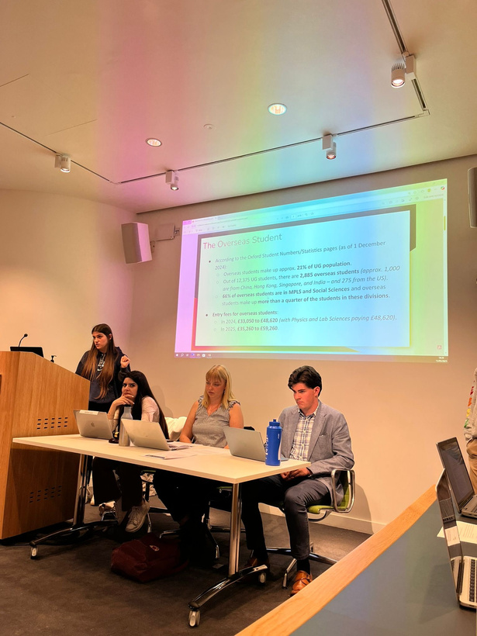

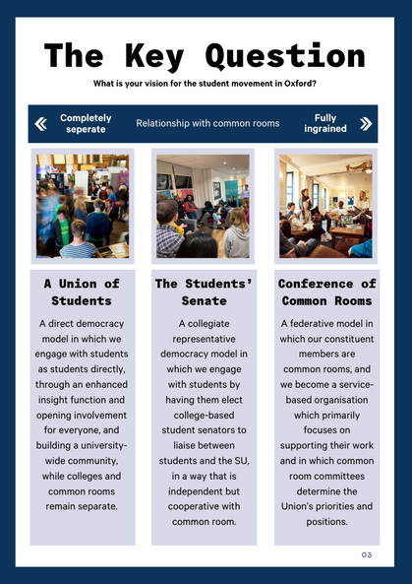
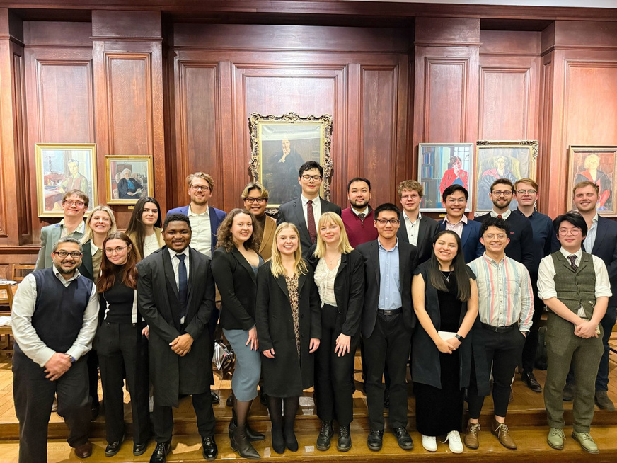
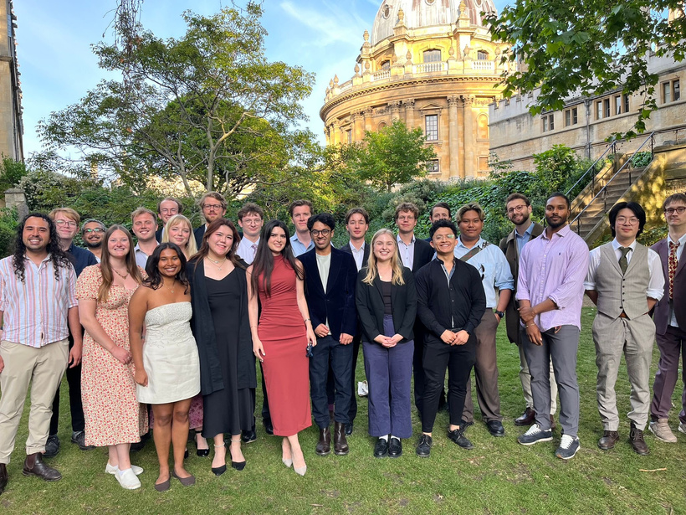
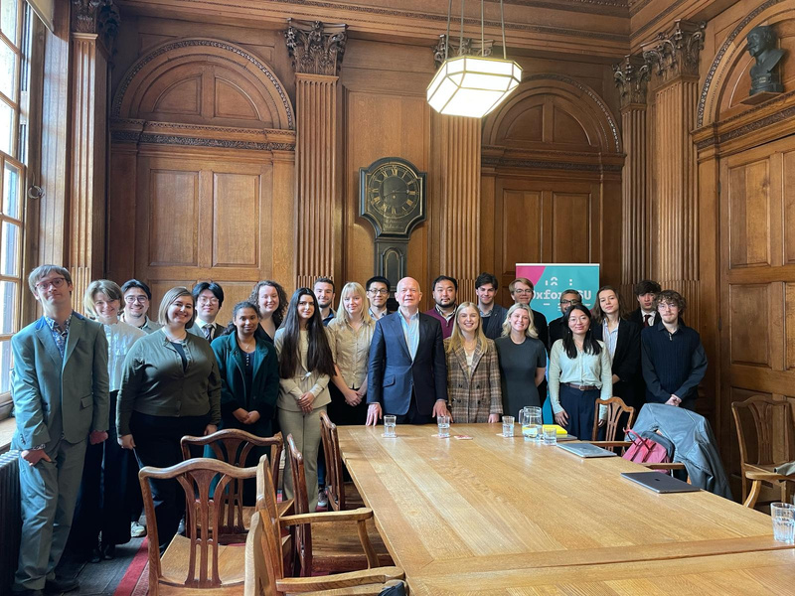
Student Engagement
Hosted Freshers Fair MT2024
Held 3 All Student Meetings
Launched a new democratic structure, CCR!
  consultation in MT
  planning throughout HT
  implementation in TT
Attended 3 JCR PresComs per term
Re-establishing MCR PresCom, meeting twice a term
Attended (almost) every RepCom
Filmed approximately X reels and social media content
Arranged and chaired a meeting between the Chancellor, Lord Hague, and CR presidents
Many other events (e.g. AI Presidents Summit, Student Leaders EDI events at the Weston)

Slide 5
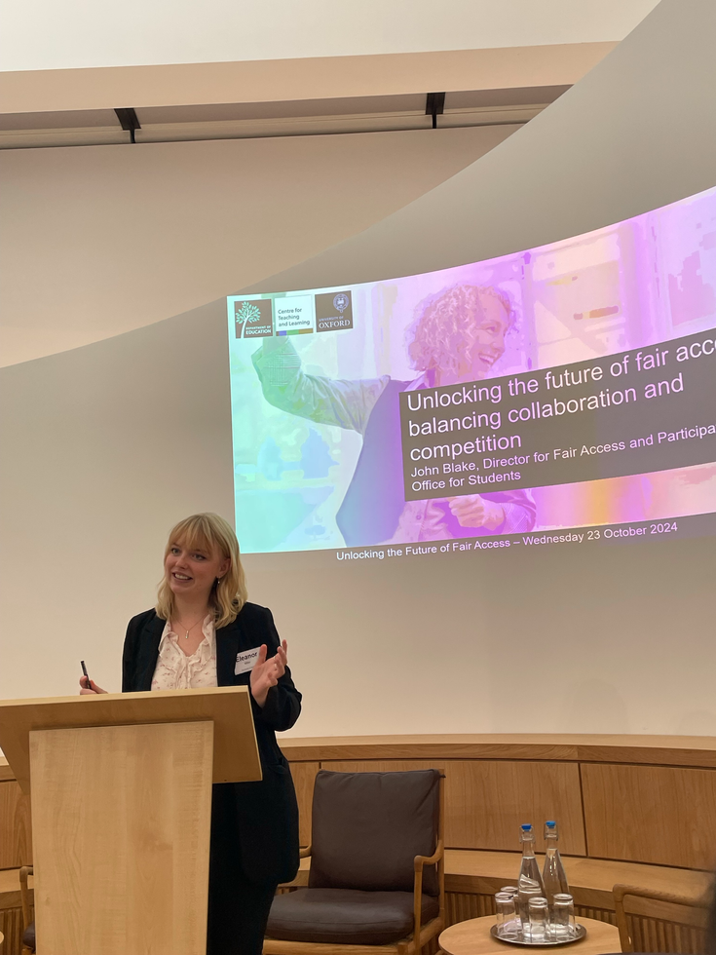
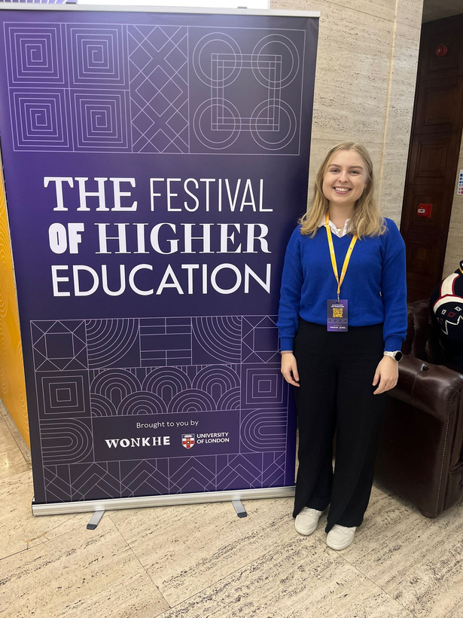
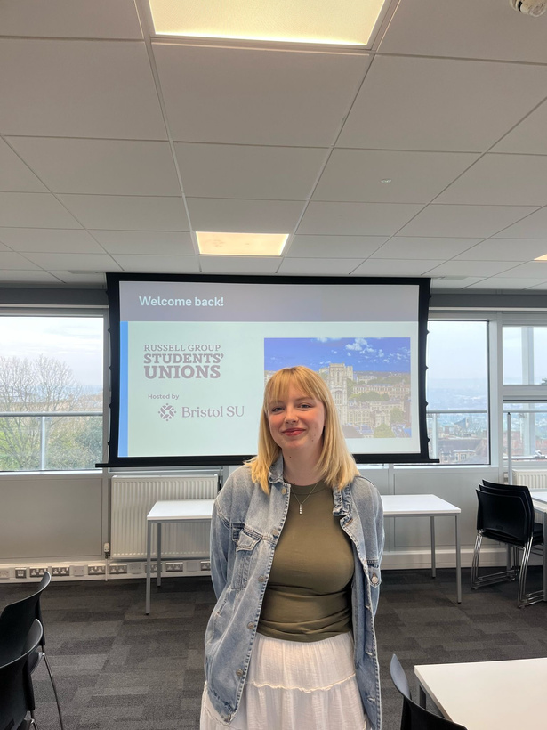
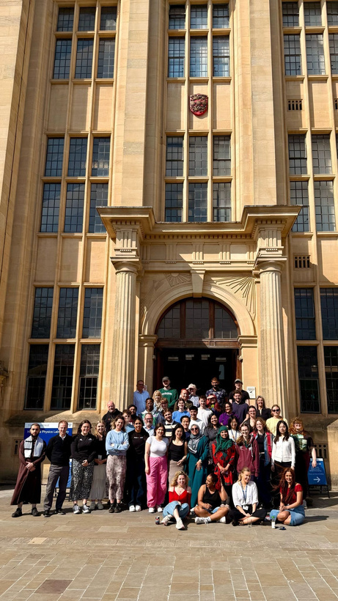
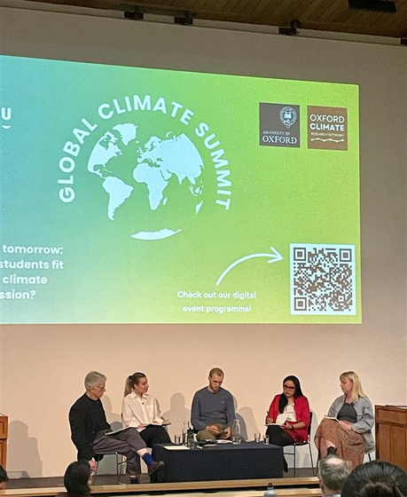
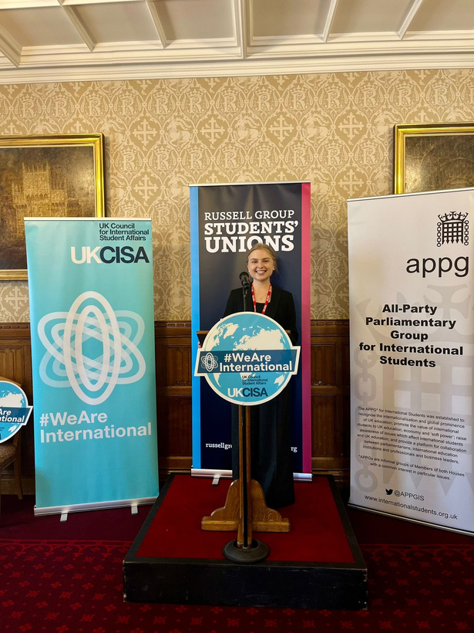
Wider Sector Engagement
We attended Russell Group Student Union Residentials in Durham, Belfast and Bristol, connecting with other sabbatical officers around the UK
Lauren attended the launch of the International Students APPG at the House of Lords in Parliament
Eleanor spoke at multiple events and panels, including the Trinity Term EDI Rountable and Unlocking the Future of Fair Access
We attended the Festival of Higher Education, Student Governor Training, NUS Lead & Change, NUS England, and Advance HE
SU hosted a student panel as part of the UN Right Here Right Now Global Climate Summit, chaired by Eleanor
Lauren met with Lord Willets with RGSU to lobby for International Students Report

Slide 6
SU Transformation Committee
  Received and approved around 37 key recommendations and oversaw the delivery and implementation of these
  Committee met 9 times, including with the full SU Trustee board, NUS and Conference of colleges representatives
  Updating key uni stakeholders on progress regularly
  Full governance review of the SU
  Review of SU People and Culture Strategy
  Review of SU Reserves Policy
Trustee Board
  As trustees we oversaw the oversaw the legal, financial and reputational integrity of the charity
  Had monthly Trustee Board meetings (with a few emergency ones for good measure)
  Eleanor was the Chair of the Board
  Lauren served on the Media Oversight Committee
  Both of us were on the selection panel for the new External Trustee
  Lauren was on the procurement panel to select the next Audit providers
  Received and approved SU budgets and management accounts
  Eleanor Co-chaired Chief Executive Management Committee (CEMC)

Slide 7
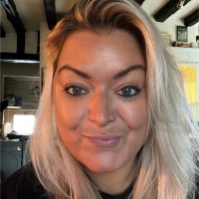
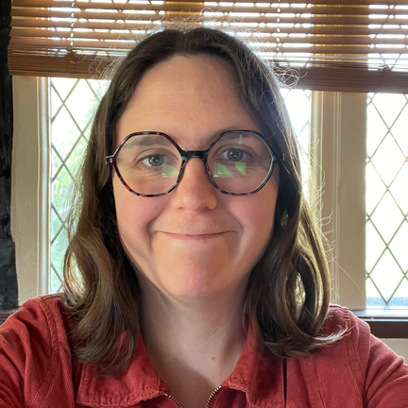
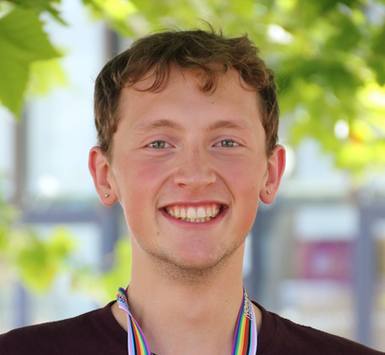
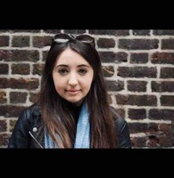
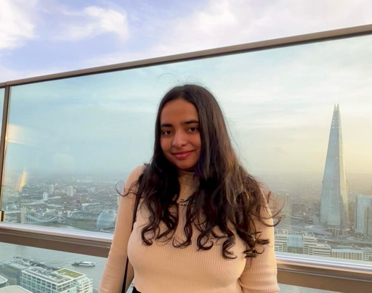
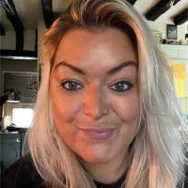
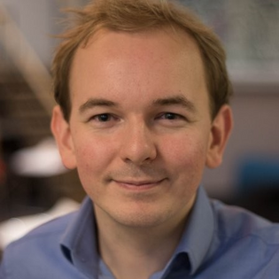
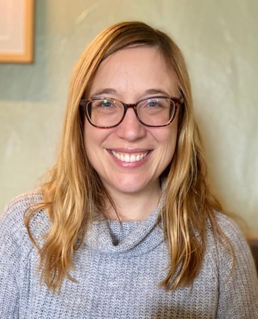
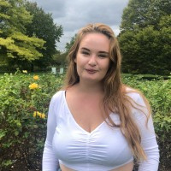
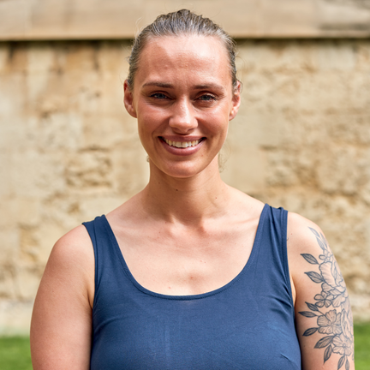
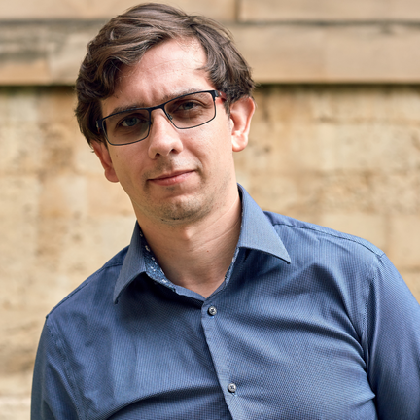
We would not have survived this year without the SU staff!

